Slide 1

FRTB · DEFAULT RISK CHARGE · SECURITISATION (NON-CTP)
Default Risk Capital for
Securitisation Positions
From holdings and model-priced market value to a single, auditable bucket-level charge — MAR22.33–35 wrapping the banking-book securitisation framework (CRE40–45).
$27.4m
24
19
6
Total securitisation DRC
positions
netted tranches
(class × region) buckets
Market Risk — FRTB Programme · Reference portfolio v5 · All figures computed by the live DRC engine

Slide 2
OBJECTIVE
Quantify default risk on the securitisation trading book as one auditable capital number
The Default Risk Charge (DRC) captures the loss if a securitisation issuer or tranche jumps to default — the discrete, gap risk that the sensitivities-based method (delta/vega/curvature) does not measure.
$27.4m
Securitisation DRC (this deck)
Scope. 24 securitisation positions across 10 deals and 6 asset classes; non-CTP only (correlation trading is out of scope for v1).
MAR22.35 — sum across 6 buckets
$341.0m
8.0%
Method. Import banking-book risk weights (CRE40–45), fix maturity at 1 year (MAR22.34(1)), then aggregate net jump-to-default per bucket with a hedge-benefit ratio.
Gross book MV
Capital intensity
basis for JTD
DRC ÷ gross MV
Output. One charge per (asset class × region) bucket; the portfolio total is the simple sum — no cross-bucket diversification (MAR22.35).
THE TAKEAWAY On a $341m securitisation book, default risk draws $27.4m of capital — and the calculation hinges on three things most desks get wrong: the maturity split, the 8% factor, and the hedge-benefit ratio.
Source: FRTB DRC securitisation engine — v5 reference portfolio
Engine: drc_main.py::run_full_drc · Artefact: drc_total_capital.xlsx
2

Slide 3
THE BOOK · SLIDE 2
24 securitisation positions span six asset classes — and the market value comes from the model, not the book
EXHIBIT 1 Securitisation holdings inventory (model-priced MV, $m)
ID | Security | Asset | L/S | MV $m | A–D % | Seniority | Sub-type
37 | RMBS-2023-1-A (Senior) | RMBS | L | 3.9 | 15–100 | Senior | Tranche
38 | RMBS-2023-1-M (Mezz) | RMBS | L | 22.0 | 5–15 | Mezzanine | Tranche
39 | RMBS-2023-1-B (Short Mezz) | RMBS | S | -3.7 | 5–15 | Mezzanine | Tranche
68 | RMBS-2023-1-A (Senior) [hedge] | RMBS | S | -3.9 | 15–100 | Senior | Tranche
69 | RMBS-2023-1-M (Mezz) [hedge] | RMBS | S | -1.1 | 5–15 | Mezzanine | Tranche
40 | CMBS-2024-RE1-A1 (Senior) | CMBS | L | 0.9 | 25–100 | Senior | Tranche
41 | CMBS-2024-RE1-A2 | CMBS | L | 6.8 | 20–25 | Mezzanine | Tranche
42 | CMBS-2024-RE1-B | CMBS | L | 11.3 | 10–20 | Junior | Tranche
71 | CMBS-2025-NEW-A (Senior) | CMBS | S | -0.9 | 25–100 | Senior | Tranche
43 | CLO-2023-LVG-A (Senior) | CLO | L | 1.5 | 30–100 | Senior | Tranche
44 | CLO-2023-LVG-B (Mezz) | CLO | L | 4.2 | 15–30 | Mezzanine | Tranche
45 | CLO-2023-LVG-C (Mezz) | CLO | L | 18.8 | 15–30 | Mezzanine | Tranche
70 | CLO-2025-NEW-A (Senior) | CLO | S | -14.8 | 30–100 | Senior | Tranche
46 | ABCP MultiSeller 2025 | ABCP | L | 30.0 | 0–100 | Senior | Tranche
73 | ABCP-MS-2025 Liquidity Facility | ABCP | L | 45.1 | 0–100 | Senior | Liquidity Facility
47 | CC-ABS-2024-A (Senior) | ABS-CreditCard | L | 15.0 | 12–100 | Senior | Tranche
48 | CC-ABS-2024-B (Mezz) | ABS-CreditCard | L | 19.7 | 6–12 | Mezzanine | Tranche
49 | CC-ABS-2024-C (Junior) | ABS-CreditCard | L | 10.5 | 0–6 | Junior | Tranche
72 | CC-ABS-2024-A (Senior) [hedge] | ABS-CreditCard | S | -15.0 | 12–100 | Senior | Tranche
50 | AUTO-2024-1-A (Senior) | ABS-Auto | L | 53.1 | 15–100 | Senior | Tranche
51 | AUTO-2024-1-B (Short Mezz) | ABS-Auto | S | -7.8 | 5–15 | Mezzanine | Tranche
74 | NPL-RMBS-2024-1-A (Senior) | RMBS | L | 15.4 | 20–100 | Senior | Tranche
75 | CC-NPL-2024-1-A (Senior) | ABS-CreditCard | L | 26.8 | 25–100 | Senior | Tranche
76 | CC-NPL-2024-1-B (Mezz) | ABS-CreditCard | L | 9.0 | 10–25 | Mezzanine | Tranche
TWO INPUT FILES
1 Holdings
Portfolio_v5 — issuer, A/D, pool ID, seniority, rating, maturity.
2 Sensitivities sheet
FRTB_Sensitivities.xlsx → Portfolio_MV_Decomposed — the model-priced, signed MV that DRC uses as gross JTD (MAR22.27).
The book MV column is deliberately ignored — pricing is model-consistent and lives upstream.
Book MV ≠ model MV
AUTO-2024-1-A $80.2m → $53.1m
RMBS-2023-1-A $4.8m → $3.9m
ABCP CP $30.0m → $30.0m
Source: FRTB DRC securitisation engine — v5 reference portfolio
Engine: drc_securitisation/sec_loader.py::build_sec_loader_frame · Artefact: drc_sec_phase1_load.xlsx
3

Slide 4
DEAL MASTER · SLIDE 3
Ten deals carry the pool parameters that drive every risk weight
EXHIBIT 2 Deal_Master — pool-level inputs to the SEC risk-weight formulas (W, K, granularity)
Pool ID | Pool type | W | K₀ IRB | K₀ SA | N | LGD | M | STC | DD | Role
RMBS-2023-1 | RMBS_prime | 1.5% | 2.0 | 2.8 | 5,000 | 25% | 3.0y | — | pass | Orig.
CMBS-2024-RE1 | CMBS_conduit | 0.5% | 6.4 | 8.0 | 60 | 40% | 4.5y | — | pass | Inv.
CMBS-2025-NEW | CMBS_conduit | 0.0% | 6.4 | 8.0 | 60 | 40% | 4.5y | — | fail | Inv.
CLO-2023-LVG | CLO_BSL | 1.2% | 10.0 | 8.0 | 150 | 45% | 4.5y | — | pass | Inv.
CLO-2025-NEW | CLO_BSL | 0.0% | 10.0 | 8.0 | 150 | 45% | 4.5y | — | pass | Inv.
ABCP-MS-2025 | ABCP_receivables | 0.3% | 4.5 | 6.0 | 50 | 50% | 1.0y | — | pass | Inv.
CC-ABS-2024 | ABS_CreditCard | 1.8% | 2.4 | 4.0 | 100,000 | 65% | 3.0y | — | pass | Orig.
AUTO-2024-1 | ABS_Auto | 1.1% | 2.8 | 4.0 | 30,000 | 45% | 2.5y | ✓ | pass | Inv.
NPL-RMBS-2024-1 | RMBS_subprime | 95.0% | 8.0 | 8.0 | 3,000 | 40% | 4.0y | — | pass | Inv.
CC-NPL-2024-1 | ABS_CreditCard | 95.0% | 12.0 | 8.0 | 50,000 | 65% | 3.0y | — | pass | Orig.
READING THE INPUTS
W share of pool 90+ days delinquent — ≥90% flags an NPL deal (CRE45.1)
K₀ banking-book capital requirement on the pool (IRB / SA) — feeds SSFA
N effective number of exposures — pool granularity for the SEC-IRBA p-factor
M pinned to 1y for RW
Source: FRTB_Sec_Config.xlsx :: Deal_Master (seeded from investor reports)
Engine: build_sec_config.py · Artefact: FRTB_Sec_Config.xlsx
4

Slide 5
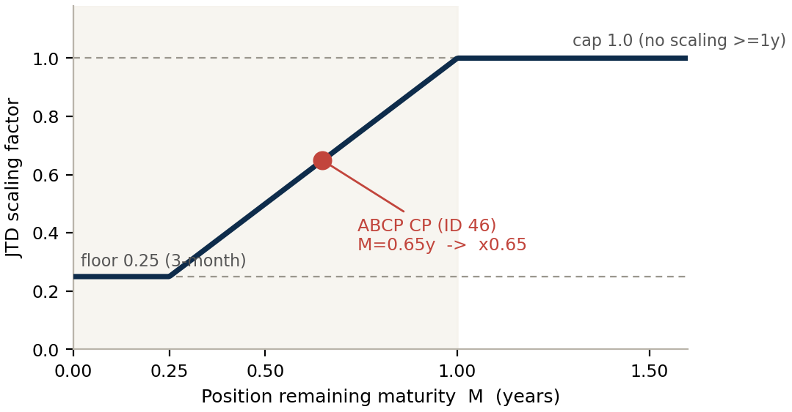
THE TRAP · SLIDE 4
Two maturity rules act on every tranche — confuse them and you double-count or under-charge
RULE 1 — RISK-WEIGHT MATURITY
RULE 2 — JTD SCALING MATURITY
EXHIBIT 3 Rule 2 — the JTD scaling factor
Fixed at M = 1 year for every tranche
MAR22.34(1) pins the RW formula to the 1-year column. Multi-year migration risk is deliberately left to CSR-Sec — counting it here too would double-charge.
Actual maturity, clipped to [0.25, 1.0]
MAR22.30/22.16-17 scales gross JTD down only for positions with under a year to run. A 6-month position is halved; 3 months or less floors at 0.25×.
THE TAKEAWAY Default risk = 1-year default risk (Rule 1). The extra capital a 5-year AAA senior should carry over a 1-year one does not live in DRC — it lives in CSR-Sec, via longer-tenor credit-spread sensitivity. Two rules, two jobs, no overlap.
WHERE RULE 2 BITES IN THIS BOOK
Only one of 24 positions is under a year: ABCP CP (ID 46), 0.65y → scaled ×0.65. Every other position runs ≥1y, so its gross JTD passes through unscaled.
Further reading
“Two Maturity Rules for Securitisations” — methodology note + LinkedIn post
Source: MAR22.34(1) RW maturity; MAR22.30/22.16-17 JTD scaling
Engine: sec_loader.py (M_T_for_drc, mat_scaling_factor) · Artefact: drc_sec_phase5_gross_scaled_jtd.xlsx
5

Slide 6
GROSS JTD · SLIDE 5
Gross JTD is simply market value — scaled down only for sub-1-year positions
Gross JTD = signed market value
MAR22.27 — LGD is already inside the SEC risk weight, so it is NOT re-applied
Maturity-scaled JTD = MV × clip(M, 0.25, 1.0)
MAR22.30 — the only place a position's real tenor enters DRC
Why no LGD × notional? For non-securitisations gross JTD = LGD × notional + P&L. For securitisations the loss-given-default is already calibrated into the CRE40–45 risk weights, so applying it again would double-count. JTD = MV.
EXHIBIT 4 Gross → maturity-scaled JTD, selected positions ($m)
ID | Security | MV (gross JTD) $m | M (yrs) | Scale × | Maturity-scaled JTD $m
46 | ABCP MultiSeller 2025 | 29.97 | 0.65 | 0.649 | 19.45
50 | AUTO-2024-1-A (Senior) | 53.12 | 3.40 | 1.000 | 53.12
42 | CMBS-2024-RE1-B | 11.32 | 8.40 | 1.000 | 11.32
45 | CLO-2023-LVG-C (Mezz) | 18.83 | 4.69 | 1.000 | 18.83
39 | RMBS-2023-1-B (Short Mezz) | -3.67 | 2.90 | 1.000 | -3.67
WORKED — ID 46
$30.0m
× 0.649 (M = 0.65y)
= $19.4m
The only scaled position in the book.
THE TAKEAWAY Gross JTD totals the book's market value; maturity scaling touches just one position. The heavy lifting is still ahead — netting, risk weights, and the HBR.
Source: FRTB DRC securitisation engine — v5 reference portfolio
Engine: sec_engine.py::step_9a_gross_maturity_scaled_jtd · Artefact: drc_sec_phase5_gross_scaled_jtd.xlsx
6

Slide 7
NET JTD · SLIDE 6
Long and short net only within an identical tranche — same pool, attachment, detachment and type
THE NETTING KEY positions collapse to one row only when all four fields match
Pool ID
+
Attachment %
+
Detachment %
+
Position sub-type
EXHIBIT 5 Netting outcomes in the v5 book
PERFECT HEDGE → 0
PERFECT HEDGE → 0
PARTIAL HEDGE
RMBS-2023-1 senior
ID 37 long + ID 68 short
+$3.9m −$3.9m
CC-ABS-2024 senior
ID 47 long + ID 72 short
+$15.0m −$15.0m
RMBS-2023-1 BBB mezz
IDs 38 long + 39, 69 short
+$22.0m −$4.8m
Net JTD = $0
Net JTD = $0
Net JTD = $17.2m
THE TAKEAWAY Netting recognises perfect long/short hedges at 100% — two senior pairs net to zero capital here. Cross-tranche hedges within a bucket get only partial credit, later, through the HBR. The book collapses from 24 positions to 19 netted tranches.
Source: MAR22.28-29 per-tranche offsetting; engine netting invariant
Engine: sec_engine.py::step_9b_net_jtd · Artefact: drc_sec_phase6_tranche_net.xlsx
7

Slide 8
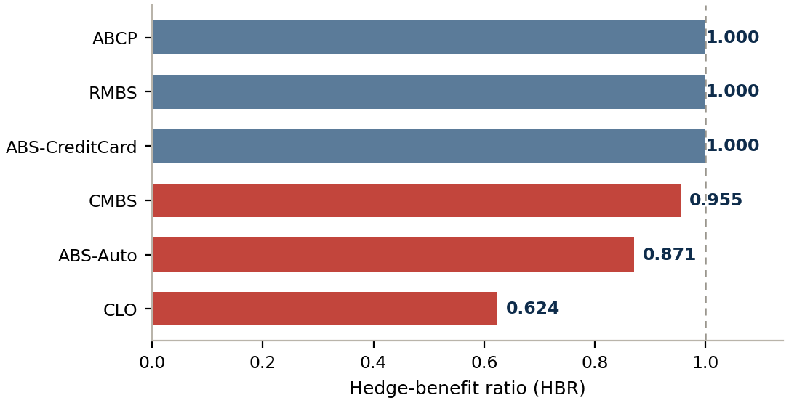
HEDGE-BENEFIT RATIO · SLIDE 7
The hedge-benefit ratio discounts net-short exposures — and reaches 1.0 only when a bucket has no shorts
HBR = Σ netJTD(long) ÷ ( Σ netJTD(long) + Σ |netJTD(short)| )
MAR22.23 — uses un-weighted net JTD; always between 0 and 1
EXHIBIT 6 HBR by bucket
WHY HBR FALLS BELOW 1
No shorts → HBR = 1.0. RMBS, ABCP and ABS-CreditCard buckets are net-long only. There is nothing to discount, so the full short leg is moot and HBR = 1.
Shorts present → HBR < 1. CLO falls to 0.62, ABS-Auto to 0.87, CMBS to 0.95. The larger the short leg relative to the longs, the lower the ratio.
It caps the hedge credit. A short position only offsets longs up to HBR × its weighted JTD. Imperfect, cross-tranche hedges are recognised — but never in full.
THE TAKEAWAY The CLO bucket shows the mechanism most clearly: a $14.8m short senior against $24.5m of longs pulls HBR to 0.62, so the short hedges only ~62 cents on the dollar.
Source: MAR22.23 / MAR22.33 hedge-benefit ratio
Engine: sec_engine.py::step_10_bucket_hbr · Artefact: drc_sec_phase7_bucket_hbr.xlsx
8

Slide 9
RISK WEIGHTS · SLIDE 8
DRC borrows the banking-book securitisation machinery wholesale — CRE40–45, with one change
MAR22.34(1) imports the banking-book risk weights verbatim and makes a single modification: maturity is fixed at 1 year. The same six chapters that set capital on the banking book set the trading-book default charge.
CRE40
General provisions
Pool classification, senior-tranche definition, due-diligence gate, 1250% residual, hierarchy, look-through cap
CRE41
SEC-SA
Standardised SSFA: Kₐ = (1−W)·K_SA + 0.5W, supervisory p, 15% floor
CRE42
SEC-ERBA
External-ratings table (18 grades × senior/non-senior × 1y/5y); thickness adj.
General provisions
SEC- SA
SEC- ERBA
CRE43
SEC-IAA
Internal assessment of unrated ABCP facilities → ECAI grade → ERBA table
CRE44
SEC-IRBA
Internal-ratings SSFA with K_IRB and the 6-row supervisory p-factor
CRE45
NPL securitisations
W ≥ 90% gate, 100% floor, senior 100% concession (NRPPD ≥ 50%)
SEC- IAA
SEC- IRBA
NPL securitisations
THE TAKEAWAY Because these are banking-book RWA risk weights — not loss rates — they run up to 1250% and must be converted to capital with the 8% factor (next-but-one slide). That single distinction is the most expensive thing to get wrong in DRC.
Source: MAR22.34 importing CRE40–45; risk weights only (not the agg. capital cap)
Engine: sec_erba.py / sec_sa.py / sec_irba.py / sec_iaa.py · Artefact: drc_sec_phase3_riskweight.xlsx
9

Slide 10
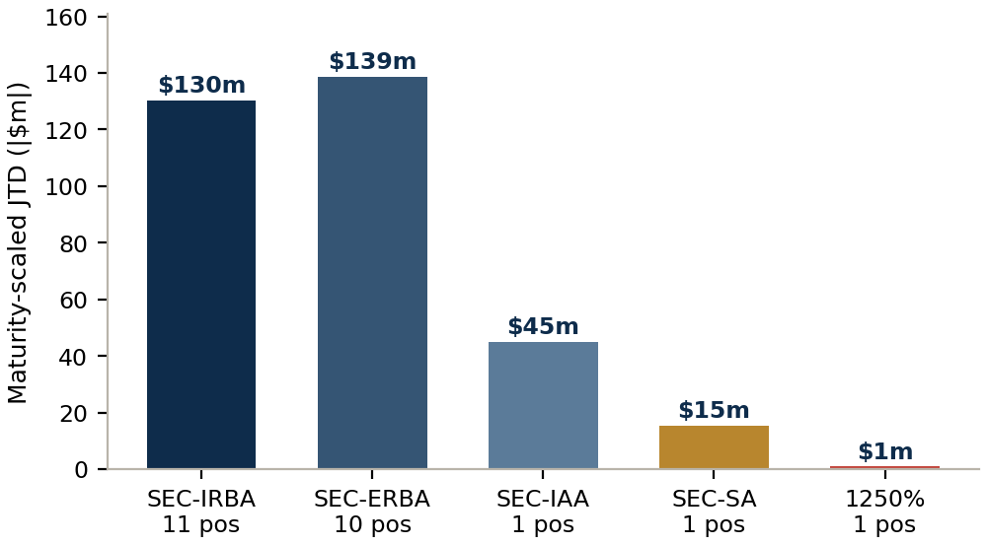
APPROACH SELECTION · SLIDE 9
The approach is forced by capability and data, not chosen — a strict hierarchy with a 1250% backstop
SEC-IRBA
Bank has IRB models for the pool AND can perform full due diligence
e.g. Originator/sponsor deals with K_IRB
EXHIBIT 7 How the v5 book routes
▼
SEC-ERBA
IRBA not available, but an eligible external rating exists
e.g. Rated investor tranches
▼
SEC-IAA
Unrated ABCP credit facility — internal assessment mapped to a rating
e.g. ABCP liquidity facility
▼
SEC-SA
No IRB, no rating, and it is a tranche (not a facility)
e.g. Unrated NPL investor tranche
All four live approaches — plus the 1250% residual — are exercised by this single book.
Single-source reliance on agency ratings is exactly what the post-2008 hierarchy was built to defeat.
▼
1250%
None of the above apply, or due diligence fails
e.g. DD-failed / no-approach residual
Source: CRE40.41–47 hierarchy of approaches
Engine: sec_hierarchy.py::route_position · Artefact: drc_sec_phase2_classify_route.xlsx
10

Slide 11
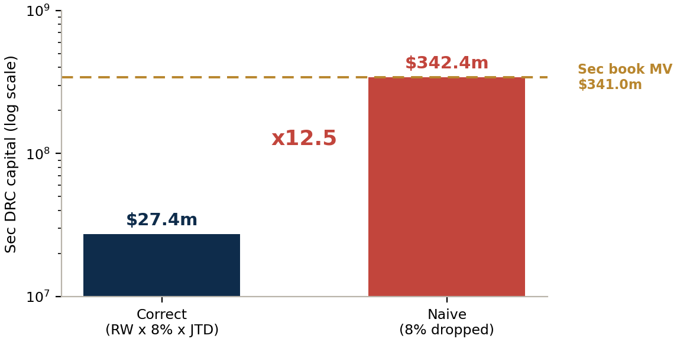
THE 8% FACTOR · SLIDE 10
Forget the 8% Cooke factor and a $27m charge balloons to $342m — larger than the book itself
A securitisation risk weight is an RWA weight (it peaks at 1250%), not a loss rate. To turn it into capital you multiply by the 8% minimum-capital ratio:
EXHIBIT 8 Sec DRC with vs without the 8% factor
capital = RW × 8% × net JTD
The ceilings give it away: 1250% × 8% = 100% — a full deduction, never more.
 | Securitisation | Non-securitisation
Risk weight is… | an RWA weight | a loss rate
Ceiling | 1250% | 100%
Apply 8%? | Yes — RW × 8% | No — already capital
“100%” means | 8% of exposure | total loss
THE TAKEAWAY Capital cannot exceed the assets it is held against. A securitisation charge bigger than the book is the unmistakable fingerprint of a dropped 8% — the error is always exactly 12.5×. Further reading: “Risk Weight or Loss Rate?” note + LinkedIn post.
Source: MAR22.34 (RW = K×12.5, CRE44.24(2)); RBC20 8% ratio
Engine: sec_engine.py (rw_factor_to_capital = 0.08) · Artefact: drc_sec_phase7_bucket_hbr.xlsx
11

Slide 12
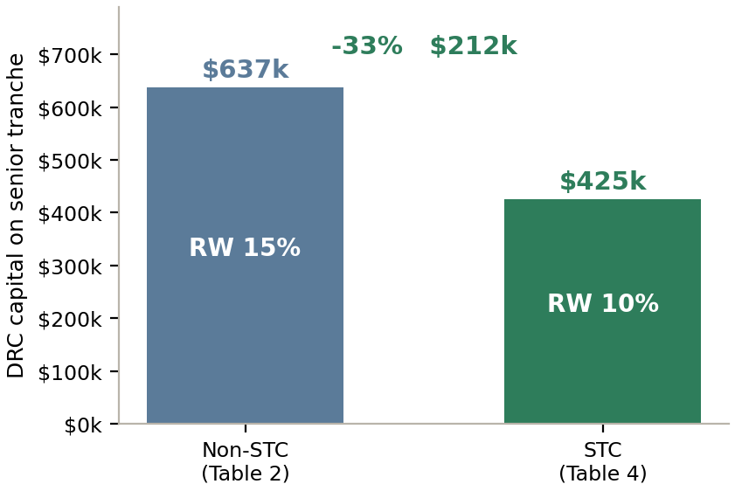
SPECIAL CASE · STC · SLIDE 11
STC status cuts the senior auto-ABS risk weight by a third — but only if due diligence holds
Simple, Transparent and Comparable is a structural quality label — not a credit grade. A qualifying deal earns a modest, bounded capital discount.
EXHIBIT 9 AUTO-2024-1-A senior — STC capital effect
Simple
Homogeneous pool, sound underwriting, true sale, no re-securitisation
Transparent
Clear waterfall, hedged mismatches, full data to investors pre- and post-pricing
Comparable
Experienced servicer, defined roles, consistent definitions
DUE DILIGENCE IS THE GATEWAY
The STC discount — or any modelled approach — may be used only if the required due diligence is performed and evidenced. A failure does not demote the position; it forces 1250% (full deduction).
WORKED EXAMPLE
Senior RW 15% → 10% (ERBA Table 2 → Table 4). Capital $637k → $425k, a saving of $212k (33%).
THE TAKEAWAY The benefit is deliberately modest — STC rewards transparency, not low risk — and it evaporates the instant due diligence lapses. Further reading: “STC — Due Diligence as the Gateway” note + LinkedIn post.
Source: CRE42.13 Table 4 (STC ERBA); CRE40.67–95 STC criteria
Engine: sec_erba.py::compute_rw (STC table select) · Artefact: drc_sec_phase3_riskweight.xlsx
12

Slide 13
SPECIAL CASE · DD FAILURE · SLIDE 12
A due-diligence failure forces 1250% — a full capital deduction, no fallback approach
Due diligence gates the use of any SEC approach (CRE40.31). If the ongoing pool-data feed, structural understanding or risk analysis cannot be evidenced, the position does not drop to SEC-SA — it goes straight to the 1250% residual.
WHY IT IS BOUNDED, NOT EXPLOSIVE
1250% looks alarming, but after the 8% factor it is exactly a 100% deduction — capital equal to the position's value, never beyond it.
Here the position is a short hedge, so its 1250% leg is discounted by the CMBS bucket HBR (0.95) before it nets against the long CMBS tranches.
The fix is operational, not financial: stand up the pool-data feed and the position re-routes to SEC-ERBA/SA.
DD status = FAIL
→
Skip SEC engine
→
RW = 1250%
→
×8% = 100% cap.
EXHIBIT 10 The DD-failed position in v5
Field | Value
Position | CMBS-2025-NEW-A (Senior) (ID 71)
Pool | CMBS-2025-NEW — new vintage, pool-data feed not yet operational
DD status | fail (CRE40.33)
Risk weight | 1250%
Model MV (net JTD) | $-897k
Capital = 1250% × 8% × |JTD| | $897k (= |MV|, full deduction)
Source: CRE40.31–36 due-diligence gate; CRE40.41 1250% residual
Engine: sec_dd.py::is_due_diligence_pass · Artefact: drc_sec_phase2_classify_route.xlsx
13

Slide 14
SPECIAL CASE · NPL · SLIDE 13
A distressed (W = 95%) pool drives punitive weights — the senior concession caps the top tranche at 100%
When ≥ 90% of a pool is non-performing (W ≥ 0.90), CRE45 takes over. A traditional deal whose non-refundable purchase price discount (NRPPD) exceeds 50% of pool outstanding lets the senior tranche skip the SSFA and take a flat 100% weight.
NRPPD GATE $220m ÷ $400m = 55% ≥ 50% ✓
WHY SO HIGH
W = 95%
of the pool is non-performing.
The mezz runs SSFA on that distress → 459% RW. The senior is only spared by the concession.
50%
EXHIBIT 11 CC-NPL-2024-1 — same distressed pool, two very different tranches
Tranche | Seniority | RW | Net JTD | Capital (RW×8%×JTD) | Treatment
CC-NPL-2024-1-A | Senior | 100% | $26.8m | $2.1m | Flat 100% concession (skip SSFA)
CC-NPL-2024-1-B | Mezzanine | 459% | $9.0m | $3.3m | Full SSFA, then 100% floor
THE TAKEAWAY The concession is relief, not a penalty: it caps the senior at $2.1m of capital. The mezzanine, run through the full SSFA on a 95%-delinquent pool, carries $3.3m — the distress shows up where there is no concession.
Source: CRE45.1 (W gate); CRE45.5 (senior concession); CRE45.4 (100% floor)
Engine: sec_npl.py::apply_npl_layer · Artefact: drc_sec_phase3_riskweight.xlsx
14

Slide 15
AGGREGATION · SLIDE 14
Every exposure lands in one (asset class × region) bucket; capital sums with no cross-bucket hedging
MAR22.31/32 defines the buckets directly from fields already on the holdings file — Underlying Pool Type × Region. The v5 book is single-region (North America), so six asset classes give six buckets.
ABS-CreditCard
RMBS
ABCP
North America
North America
North America
5 tranches · long-only
DRC $11.8m
3 tranches · long-only
DRC $11.7m
2 tranches · long-only
DRC $2.0m
CMBS
CLO
ABS-Auto
North America
North America
North America
4 tranches · 1 short
DRC $1.4m
3 tranches · 1 short
DRC $377k
2 tranches · 1 short
DRC $130k
THE TAKEAWAY No cross-bucket diversification is allowed — the portfolio charge is the simple sum of the six bucket numbers (MAR22.35). Hedging only counts inside a bucket, and only through the HBR.
Source: MAR22.31/32 bucket definition (Underlying Pool Type × Region)
Engine: sec_engine.py::step_10_bucket_hbr · Artefact: drc_sec_phase7_bucket_hbr.xlsx
15

Slide 16
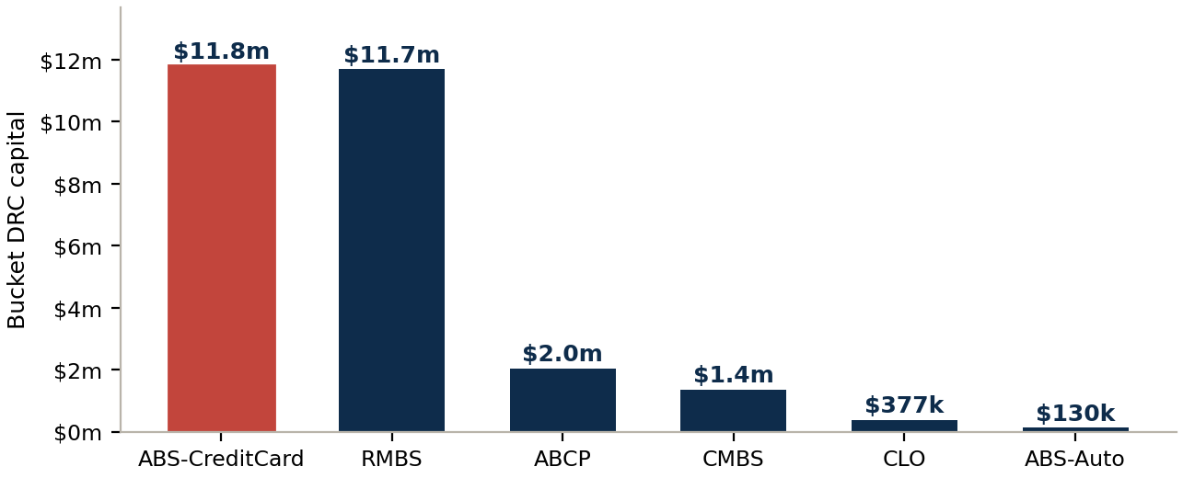
BUCKET CAPITAL · SLIDE 15
Bucket DRC = risk-weighted net long − HBR × net short, floored at zero
DRCbucket = max[ Σ (RW × 8% × netJTD)long − HBR × Σ (RW × 8% × |netJTD|)short , 0 ]
EXHIBIT 12 Per-bucket capital build-up ($)
EXHIBIT 13 Bucket DRC
Bucket | Long capital | Short capital | HBR | Bucket DRC
ABS-CreditCard | $11.80m | — | 1.000 | $11.80m
RMBS | $11.68m | — | 1.000 | $11.68m
ABCP | $2.04m | — | 1.000 | $2.04m
CMBS | $2.22m | $897k | 0.955 | $1.36m
CLO | $488k | $178k | 0.624 | $377k
ABS-Auto | $425k | $339k | 0.871 | $130k
TOTAL (MAR22.35) |  |  |  | $27.39m
THE TAKEAWAY Two credit-card buckets and RMBS account for the bulk of the charge; the netted, HBR-discounted CLO, ABS-Auto and CMBS buckets contribute little. The floor at zero means an over-hedged bucket can never generate negative capital.
Source: MAR22.25 bucket DRC; MAR22.33 HBR; MAR22.34(3) FV cap
Engine: sec_engine.py::step_10_bucket_hbr · Artefact: drc_sec_phase7_bucket_hbr.xlsx
16

Slide 17
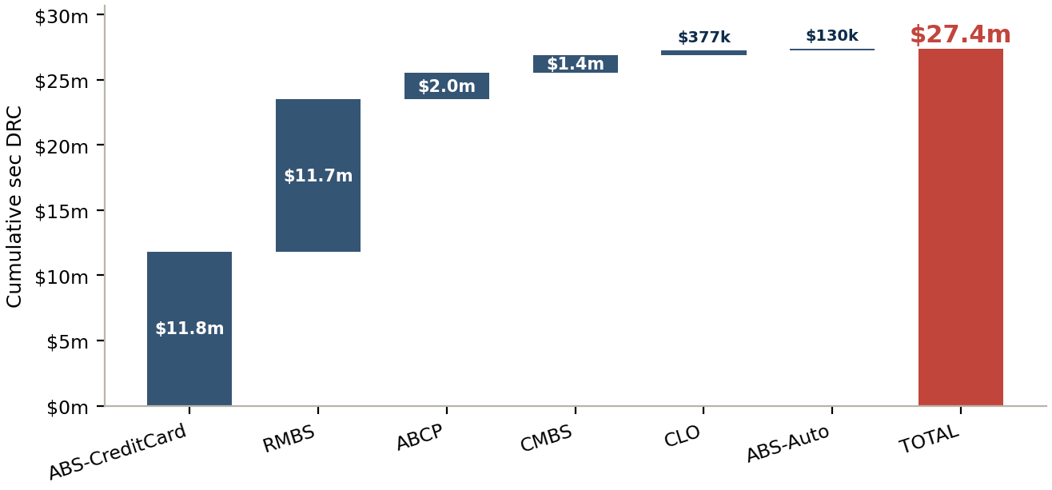
RESULT · SLIDE 16
Total securitisation Default Risk Charge: $27.4m
EXHIBIT 14 Build-up of the securitisation DRC across six buckets ($)
$27.4m
Securitisation DRC
6 buckets, MAR22.35 simple sum
$562k
$28.0m
Non-sec DRC
Total DRC
MAR22.22-32 (context)
sec + non-sec
THE NUMBER, AND THE THREE LEVERS
• The 8% factor keeps the charge ($27m) far below the naïve $342m.
• Maturity is split: default → DRC, migration → CSR-Sec.
• Netting + HBR convert a gross $341m book into a defensible charge.
THE TAKEAWAY Every figure in this deck is computed by the live engine and snapshot to an auditable Excel artefact per phase — any reviewer can re-run any step from the previous phase's output.
Source: MAR22.35 total securitisation DRC
Engine: sec_engine.py::run_engine (MAR22.35 sum) · Artefact: drc_sec_phase8_total.xlsx
17

Slide 18
ENGINEERING · MODULE ARCHITECTURE
A modular engine — one CRE chapter per file, one orchestrated pipeline
drc_main.py
unified entry — runs sec + non-sec
→
sec_engine.py — 10-step chain · enforces the per-tranche netting invariant · applies bucket HBR (MAR22.33)
INPUTS
INGEST & ROUTE
RISK-WEIGHT ENGINES
OVERLAYS & CAPS
OUTPUTS
Portfolio holdings
sec_loader.py
sec_erba.py
sec_npl.py
phase_snapshot.py
issuer, A/D, pool, seniority, rating, maturity
join holdings + config; derive tranche_key, is_senior, M=1 overlay
CRE42 ratings tables 1–4, interpolation, thickness adj
CRE45 W-gate, 100% floor, senior concession
shared 5-sheet writer: manifest · input · output · audit · recon
▸
sec_classifier.py
sec_irba.py
sec_caps.py
▸
Sensitivities sheet
CRE40.15–18 pool class + senior-from-waterfall
CRE44 SSFA + supervisory p-formula
CRE40.50–51 look-through cap + floors
8 phase Excels
Portfolio_MV_Decomposed — model-priced signed MV = JTD
one per step — re-runnable, audit-traceable
sec_hierarchy.py
sec_iaa.py
sec_crm.py
FRTB_Sec_Config.xlsx
CRE40.41–47 route to the forced approach
CRE43 internal grade → ECAI → ERBA
CRE40.56–65 bought-protection decomposition
drc_total_capital.xlsx
RW tables, floors, Deal_Master, capabilities, permissions
sec_dd.py
sec_sa.py
combined sec + non-sec summary
CRE40.31–36 due-diligence gate → 1250%
CRE41 SSFA on Ka; resec p = 1.5
THE TAKEAWAY One regulatory concern per file (one CRE chapter => one module), the orchestrator owns sequence and the netting invariant, and every constant lives in config — so a Basel update is a data edit, not a code change. Each step also self-documents via a 5-sheet phase Excel.
Source: drc_securitisation/ — 12 focused modules + shared phase_snapshot.py
Engine: sec_engine.py (10-step orchestration) · Artefact: 8 phase snapshots + drc_total_capital.xlsx
18

